Slide 1
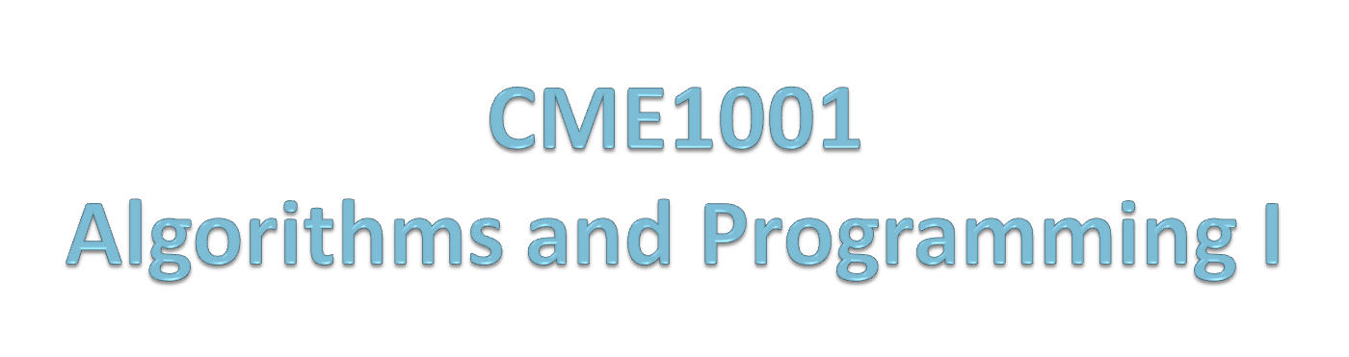
Recursive Programming
Prof. Dr. Alp KUT
Asst. Prof. Dr. Derya BİRANT

Slide 2
OUTLINE
Recursive Programming
Recursion vs Iteration
Direct vs Indirect Recursion
When to use Recursion
Drawbacks and Benefits of Using Recursion
Examples

Slide 3
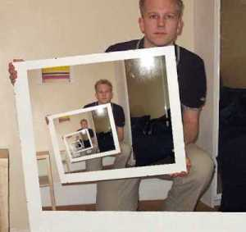
Recursive Programming
Recursive procedure is a procedure that keeps calling itself until some stop criteria is true.
Recursive Programming is a problem solving technique, where a function calls itself to fullfill a certain task.

Slide 4
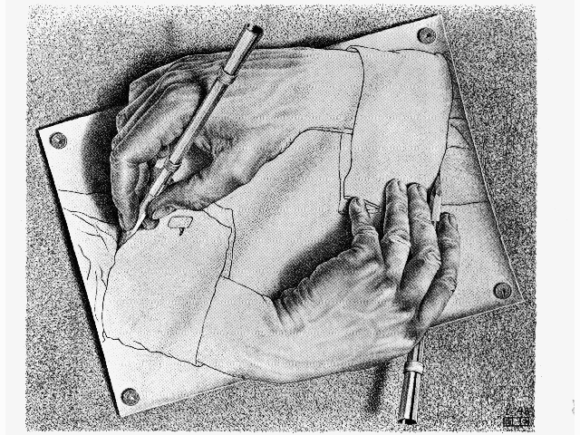
Recursive Procedure
static void Tell_Story()
{
Console.WriteLine("Once upon a time there was a mountain.");
Console.WriteLine("On the mountain, there was a temple.");
Console.WriteLine("In the temple, there was an old monk.");
Console.WriteLine("The old monk told the younger one a story.");
Console.WriteLine("What is the story? It is: ");
Tell_Story();
}
There MUST be a stop criteria !!

Slide 5
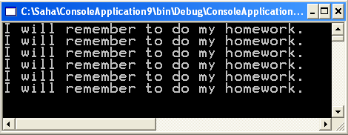
Example
static void IFORGOT(int n)
{
if (n>0)
{
Console.WriteLine("I will remember to do my homework.");
IFORGOT(n-1);
}
}
static void Main(string[] args)
{
IFORGOT(6);
}

Slide 6
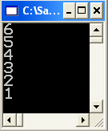
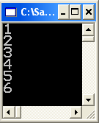
Recursion Example
What is the difference?
static void RecursiveDemo(int n)
{
if (n>0)
{
Console.WriteLine(n);
RecursiveDemo(n-1);
}
}
static void Main(string[] args)
{
RecursiveDemo(6);
}
static void RecursiveDemo(int n)
{
if (n>0)
{
RecursiveDemo(n-1);
Console.WriteLine(n);
}
}
static void Main(string[] args)
{
RecursiveDemo(6);
}

Slide 7
Recursion vs Iteration
Iteration:
  Uses repetition structures (for, while or do…while)
  Repetition through explicitly use of repetition structure
  Terminates when loop-continuation condition fails
  Controls repetition by using a counter
Recursion:
  Uses selection structures (if, if…else or switch)
  Repetition through repeated method calls
  Terminates when base case is satisfied
  Controls repetition by dividing problem into simpler one

Slide 8


Factorial Example (Calculate 5!)
Using a loop
Using recursion
(Iteration)
int facto = 1;
for (int i = 1; i <= 5; i++)
facto = facto * i;
Console.WriteLine(facto);
(Recursion)
static int factorial(int n)
{
if (n == 1) return 1;
else return n * factorial(n-1);
}
static void Main(string[] args)
{
int facto = factorial(5);
Console.WriteLine(facto);
}
1

Slide 9
Factorial Example
Using that recursive definition to get 5!
  5! = 5 * factorial(5-1)!
  5! = 5 * 4 * factorial(4-1)!
  5! = 5 * 4 * 3 * factorial(3-1)!
  5! = 5 * 4 * 3 * 2 * factorial(2-1)!
  5! = 5 * 4 * 3 * 2 * 1! (the base case)
  5! = 5 * 4 * 3 * 2 * 1
  5! = 120
static int factorial(int n)
{
if (n == 1) return 1;
else return n * factorial(n-1);
}

Slide 10
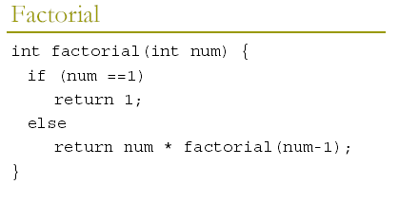
Factorial Example
return 120
main
return 24
factorial
factorial(5)
return 6
factorial
factorial(4)
return 2
factorial
factorial(3)
return 1
factorial
factorial(2)
factorial
factorial(1)

Slide 11
Base Case – Recursive Step
Base case: Part of the definition that is not recursive
It allows the recursion to terminate
Recursive step: Part of the definition that is recursive
Example:
Base case
Recursive step

Slide 12
SUM Example
Solve the sum of 1 to N problem
Iterative version
Recursive version
int sum = 0;
int N = 10;
for (int num = 1; num <= N; num++)
sum = sum + num;
Console.WriteLine(sum);
static int SUM(int num)
{
if (num == 1)
return 1;
else
return num + SUM(num - 1);
}
static void Main(string[] args)
{
int result = SUM(10);
Console.WriteLine(result);
}
Base case
Recursive step

Slide 13
SUM Example
result = 6
main
sum(3)
sum
result = 3
sum(2)
sum
result = 1
static int SUM(int num)
{
if (num == 1)
return 1;
else
return num + SUM(num - 1);
}
sum(1)
sum

Slide 14
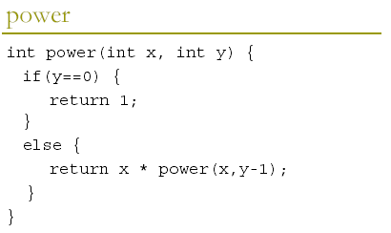
Power Example
Write a recursive program finds the y^{th} power of a given number x. x^{y}

Slide 15
GCD Example
Determine the greatest common denominator of two numbers n1 and n2
Solution: find remainder using the MOD function
If the remainder ≠ 0 shift low number to high and remainder to low.
Repeat until remainder = 0.
n1 | n2 | MOD(n1,n2) | Next step
110 | 85 | 25 | Calls function with (85,25)
85 | 25 | 10 | Calls function with (25,10)
25 | 10 | 5 | Calls function with (10,5)
10 | 5 | 0 | Returns n2 (5)

Slide 16
GCD Example
static int GCD(int n1, int n2)
{
int remainder=n1 % n2;
if (remainder==0)
return n2;
else
return GCD(n2,remainder);
}
static void Main(string[] args)
{
int result = GCD(110,85);
Console.WriteLine(result);
}
n1 | n2 | MOD(n1,n2)
110 | 85 | 25
85 | 25 | 10
25 | 10 | 5
10 | 5 | 0

Slide 17

Fibonacci Numbers
Write a procedure that computes the n^{th} Fibonacci number.
F₀ | F₁ | F₂ | F₃ | F₄ | F₅ | F₆ | F₇ | F₈ | F₉ | F₁₀ | F₁₁ | F₁₂ | F₁₃ | F₁₄ | F₁₅ | F₁₆ | ...
0 | 1 | 1 | 2 | 3 | 5 | 8 | 13 | 21 | 34 | 55 | 89 | 144 | 233 | 377 | 610 | 987 | ...
static int fibo(int n)
{
if (n <= 1) return n;
else return fibo(n-1)+fibo(n-2);
}
static void Main(string[] args)
{
Console.WriteLine(fibo(10));
Console.ReadLine();
}

Slide 18
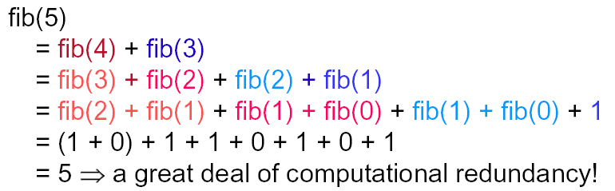
Fibonacci Numbers
static int fibo(int n)
{
if (n <= 1) return n;
else return fibo(n-1)+fibo(n-2);
}

Slide 19
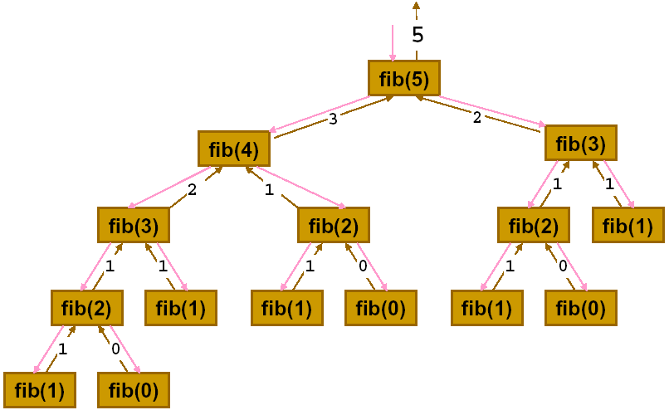
Fibonacci Numbers
static int fibo(int n)
{
if (n <= 1) return n;
else return fibo(n-1)+fibo(n-2);
}

Slide 20
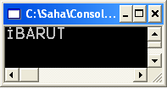
String Reversal Example
Reverse a string
static string reverse(string str)
{
if (str.Equals(""))
return "";
else
return reverse(str.Substring(1)) + str.Substring(0,1);
}
static void Main(string[] args)
{
Console.WriteLine(reverse("TURABİ"));
Console.ReadLine();
}

Slide 21
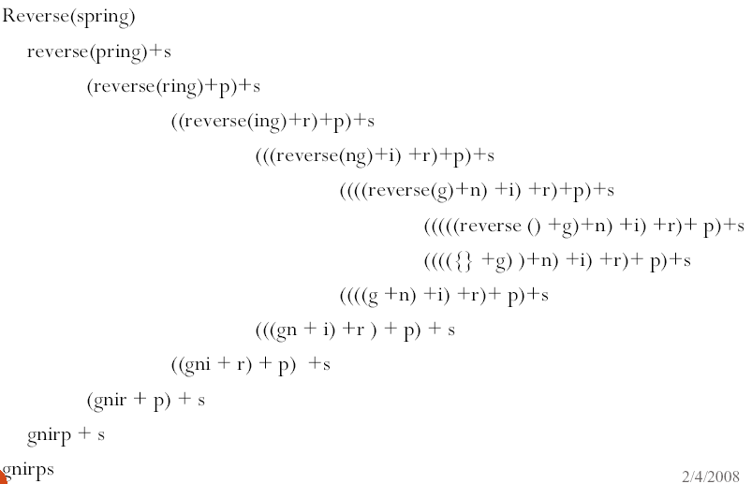
String Reversal Example

Slide 22
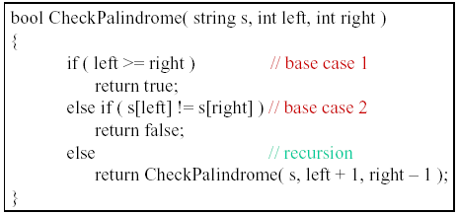
Palindrome Example
Write a function that checks a given string is palindrome or not.

Slide 23
Example with Arrays
Write a recursive algorithm to add all numbers in an integer array.
static int SUM(int[] arr,int x)
{
if (x < 1)
return 0;
else
return arr[x-1] + SUM(arr, x-1);
}
static void Main(string[] args)
{
int[] a = new int[4]{5,2,9,4};
Console.WriteLine(SUM(a,a.Length));
Console.ReadLine();
}

Slide 24
Direct vs Indirect Recursion
Direct recursion is when a method calls itself.
Indirect recursion is when a method calls a second method (and/or perhaps subsequent methods) that can call the first method again.
method1
method2
method3
method1
method2
method3
method1
method2
method3

Slide 25
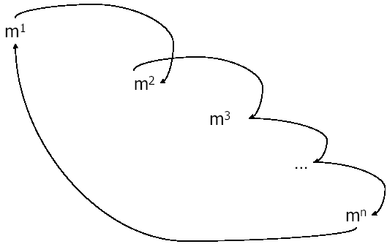
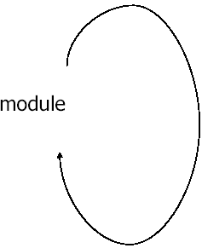
Direct vs Indirect Recursion
procedure proc()
{
...
proc ();
...
}
procedure proc1()
{
...
proc2();
}
procedure proc2()
{
...
proc3;
}
procedure proc3()
{
...
proc1();
}
Direct Recursion
Indirect Recursion

Slide 26
Indirect Recursion Example
A given number is even or not
static bool even(int x)
{
if (x == 0)return true;
else return odd(x-1);
}
static bool odd(int x)
{
if (x == 0)return false;
else return even(x-1);
}
static void Main(string[] args)
{
Console.WriteLine(even(8));
Console.ReadLine();
}

Slide 27
Drawbacks and Benefits of Using Recursion
Drawbacks
Function/procedure calls can be costly
Uses up memory
Uses up time
Benefits
Simpler solution that’s more elegant (for some problems)
Easier to visualize solutions

Slide 28
Recursive vs Non-Recursive Code
Recursive Code | Non-Recursive
Code typically has fewer lines. Code can be conceptually simpler, depending on your perspective. Often easier to maintain. | Code is longer. Code executes faster, depending on hardware and programming language.

